Slide 1

Recitation 05
Theivendiram Pranavan
pranavan@nus.edu.sg

Slide 2
Weekly Puzzle
You have a function rand5() that generates a random integer from 1 to 5. Use it to write a function rand7() that generates a random integer from 1 to 7. Comment on your proposed approach whether it will end in a number of calls to the function, rand5() or not.

Slide 3
Recitation goal
Show how augmentation is a powerful means for trees to "summarize" data of its subtrees.

Slide 4
Problem 1

Slide 5
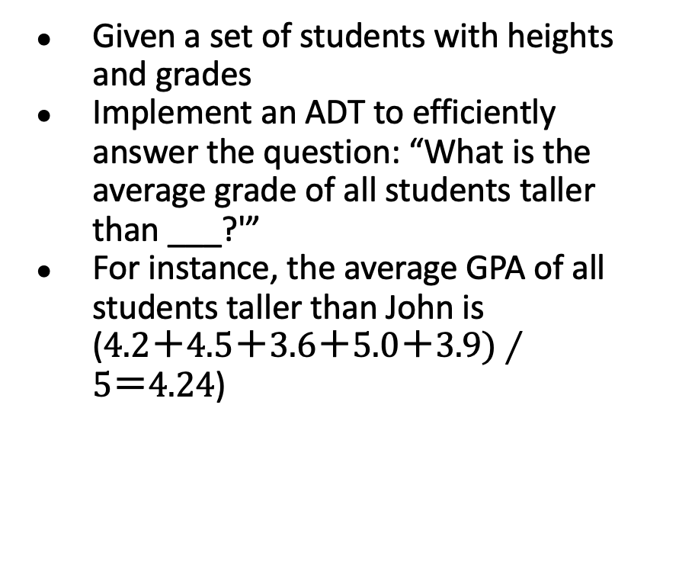
Heights and Grades
Given a set of students with heights and grades
Implement an ADT to efficiently answer the question: “What is the average grade of all students taller than ___?'”
For instance, the average GPA of all students taller than John is ($4.2＋4.5＋3.6＋5.0＋3.9)∕5＝4.24$)
Name | Height (cm) | Grade (GPA)
Charles | 176 | 4.2
Bob | 162 | 4.5
Mary | 180 | 3.6
John | 155 | 4.1
Wick | 186 | 5.0
Alice | 170 | 3.9

Slide 6
Problem 1.a.
How do you capture the information of each student? What should the data type for each of their attributes be?
Notes:
Name String
Height int
Grade float

Slide 7
Problem 1.a.
How do you capture the information of each student? What should the data type for each of their attributes be?
Name String
Height int
Grade float
Notes:
Name String
Height int
Grade float

Slide 8
ADT
Operation | Behaviour
insert(name, height, grade) | Inserts student into the dataset.
findAverageGrade(name) | Returns the average grade among all the students that are taller than the given student.

Slide 9
Problem 1.b.
How do you design a Data Structure (DS) that serves as an efficient implementation of the given ADT?
You may assume that name and height are unique.

Slide 10
2 stage query
nameTable
heightTree
Key:height
176
25.3
Value:
gradeSum
weight
Key | Value
"Charles" | 176
"Bob" | 162
"Mary" | 180
"John" | 155
"Wick" | 186
"Alice" | 170
6
162
12.5
180
8.6
3
2
155
4.1
170
3.9
186
5.0
1
1
1

Slide 11
findAverageGrade(“John”)
Finding average grade now is simple for this case:
In heightTree, remove John’s gradeSum and weight from root, then divide like so:
(25.3－4.1)∕(6－1)＝4.24
Is this strategy always correct? I.e. Do we simply deduct target node’s value away from root?
176
25.3
6
162
12.5
180
8.6
3
2
155
4.1
170
3.9
186
5.0
1
1
1
John

Slide 12
findAverageGrade(“Alice”)
What happens in this case?
If we follow the same naive strategy as before, we would have erroneously also counted in the people who are shorter than us!
We must therefore traverse the tree and figure out what to add/subtract!
176
25.3
6
162
12.5
180
8.6
3
2
155
4.1
170
3.9
186
5.0
1
1
1
Alice

Slide 13
findAverageGrade strategy
In heightTree, the root node’s value stores the total number of students (root.weight) as well as their combined grade (root.gradeSum)
We just need to deduct from root’s value the value of our query student (stuH), as well as all those values of students who are shorter than stuH
Doing so will leave us with the total number of students taller than stuH as well as their combined grade

Slide 14
findAverageGrade algorithm
Initialize variables for decumulation
tallerGradeSum = root.gradeSum
tallerWeight = root.weight
We traverse from root down to stuH, suppose current node is w
Once we have to recurse down to right child in the next step
From tallerGradeSum and tallerWeight respectively, we deduct
w’s grade and 1 (tallerGradeSum -= w’s grade, tallerWeight -= 1)
w.leftChild’s gradeSum and weight (tallerGradeSum -= w.leftChild’s gradeSum, tallerWeight -= w.leftChild’s weight)
Realize this is nothing but first deducting w’s values then adding by w.rightSubtree’s values (because we over-deducted)
Not forgetting to also finally deduct stuH and its left child (if exist)
Return tallerGradeSum/tallerWeight
heightTree
w
stuH
These correspond to students shorter than stuH

Slide 15
findAverageGrade strategy
Here I only presented one possible solution. There are obviously various ways to solve this problem
There are other possible variations:
Instead of traversing downwards from root to stuH, traverse upwards from stuH to root
Instead of decumulation, accumulate the values of students taller than stuH
Design each node in heightTree to only store gradeSum and weight of its right child
All of them are potentially workable solutions! Try implementing them in pseudocode and trace them out!
Key thing here is that you are using data-summarisation ability of augmented trees to help you compute the answer so you don’t have to visit every node in the tree

Slide 16
Test yourself!
What if we disallow hashtables?
Can you come up with an alternative for nameTable?

Slide 17
2 BSTs!
nameTree
heightTree
Key:name
C
176
Value:height
Key:height
176
25.3
Value:
gradeSum
weight
6
B
162
M
180
162
12.5
180
8.6
3
2
A
170
J
155
W
186
155
4.1
170
3.9
186
5.0
1
1
1

Slide 18
Problem 1.c.
What if height is now not unique?
What issue(s) will arise from this?
How might you modify your solution in the previous part to resolve the issue(s)?

Slide 19
insert(“Peter”, 176, 4.8)
So now we have a new student Peter who is 176cm tall.
We already have a student (Charles) with height 176.
What do we do now???
176
25.3
6
162
12.5
180
8.6
3
2
155
4.1
170
3.9
186
5.0
1
1
1

Slide 20
Key duplicates
Realistically speaking, the data might contain certain keys with high duplicate count. This is especially true for something like height in a large group of people.
Having too many duplicate keys in a BST can lead to non-optimal insertion and a potentially complicated (read: bug-prone) querying process.
There exists an easy and optimal solution to handle duplicate height in this problem :)

Slide 21
insert(“Peter”, 176, 4.8)
We can simply treat each node as a bucket of students!
You should convince yourself that doing so wouldn’t affect any operation.
176
30.1
Just throw into this bucket!
7
162
12.5
180
8.6
3
2
155
4.1
170
3.9
186
5.0
1
1
1

Slide 22

Challenge yourself!
Depending on your answer for 1.a. along with other reasonable assumptions, there is another possible solution which requires $O(n log⁡n)$ preprocessing time and thereafter $O(1)$ query time!
Can you come up with such a solution?

Slide 23
Challenge yourself!
We have conveniently avoided mentioning about tree rebalancing in an augmented BST tree.
How would rebalancing work with augmented nodes in the tree here?

Slide 24
Problem 2

Slide 25
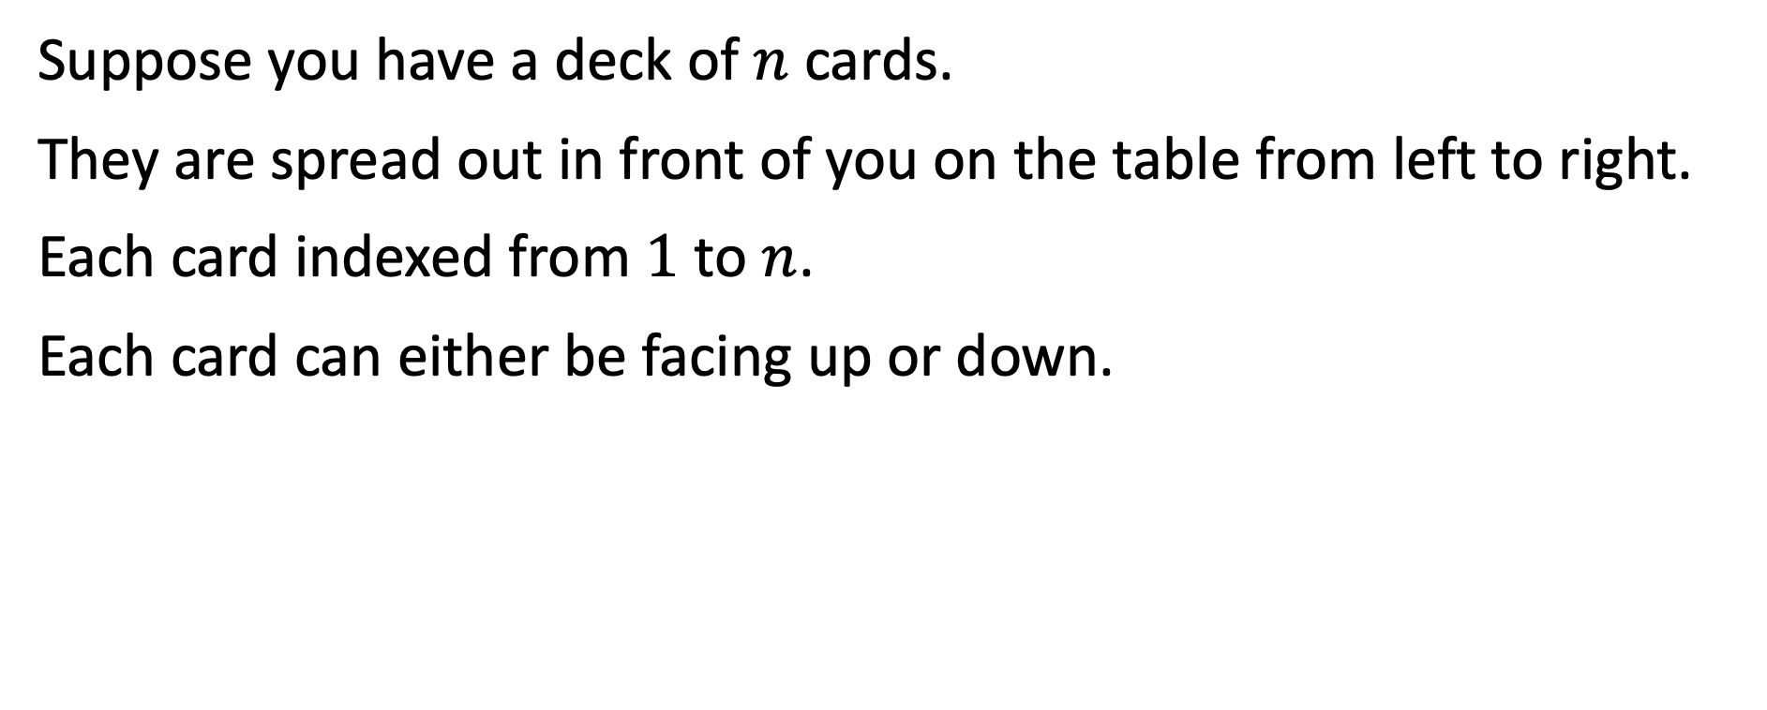
A game of cards
Suppose you have a deck of $n$ cards.
They are spread out in front of you on the table from left to right.
Each card indexed from $1$ to $n$.
Each card can either be facing up or down.

Slide 26
ADT
Operation | Behaviour
query(i) | Return whether card at index i is facing up or down.
turnOver(i,j) | Turn over all cards in the subsequence specified by the index range [i, j].

Slide 27

Problem 2.a.
Given $n$ cards already laid out on the table, how do you design a DS that implements such an ADT?
Can you achieve turnOver(i,j) in less than $O(n)$ time? Just like magic!

Slide 28
Problem 2.a.－Approach
Perhaps let’s start with a simpler problem.
Suppose all cards (say we have 8) are initially facing downwards.
How can we use augmented trees to turn over all cards at once?

Slide 29
Toggling all cards
Use an augmented tree with root summarising face direction for all the cards! We can just use a bit for the state.
0
1
2
3
4
5
6
7
8

Slide 30
Toggling all cards
Toggle state bit at root node to turn over all the cards
1
1
2
3
4
5
6
7
8

Slide 31
Problem 2.a.－Approach
Ok that was easy!
Now let’s solve a slightly harder problem.
What if, in addition to having the ability of turning over all cards at once, we can also choose to turn over half of them?

Slide 32
Also toggling ½ the cards
We just add another layer after the root node. Simple!
0
0
0
1
2
3
4
5
6
7
8

Slide 33
Also toggling ½ the cards
Toggling that new node now turns over half the cards!
0
1
0
1
2
3
4
5
6
7
8

Slide 34
Also toggling ½ the cards
Toggling the root node still turns over all the cards.
1
1
0
1
2
3
4
5
6
7
8

Slide 35
Problem 2.a.－Approach
Ok that was easy too!
Now what about also being able to turn over a quarter of the cards?

Slide 36
Also toggling ¼ of the cards
We just add another layer after the root node. Simple!
0
0
0
0
0
0
0
1
2
3
4
5
6
7
8

Slide 37
Also toggling ¼ of the cards
Toggling that new node now turns over a quarter of the cards!
0
0
0
1
0
0
0
1
2
3
4
5
6
7
8

Slide 38
Problem 2.a.－Approach
Now what about also being able to turn over every single card individually?

Slide 39
Also toggling every single card
We also attach a bit to every card!
0
0
0
0
0
0
0
1
0
2
0
3
0
4
0
5
0
6
0
7
0
8
0

Slide 40
Also toggling every single card
So turning over card 3 is as simple as this!
0
0
0
0
0
0
0
1
0
2
0
3
1
4
0
5
0
6
0
7
0
8
0

Slide 41
Problem 2.a.－Approach
But wait a minute!
How do we even find the card we want to flip in the first place?

Slide 42
How do we query(3)?
How do we even navigate such a tree to do search?
0
0
0
0
0
0
0
1
0
2
0
3
0
4
0
5
0
6
0
7
0
8
0

Slide 43
How do we query(3)?
Simple! We, turn it into a BST!
Keys of each node here is simply the mean of its children’s keys.
4
0
<=4
>4
2
0
6
0
<=2
>2
<=6
>6
1
0
3
0
5
0
7
0
<=1
>1
<=3
>3
<=5
>5
<=7
>7
1
0
2
0
3
0
4
0
5
0
6
0
7
0
8
0

Slide 44
turnOver(1,4)
Start out at the root node.
Key range of current node is [1,8]
[1,4] <= 4 so we recurse to left subtree
4
0
2
0
6
0
1
0
3
0
5
0
7
0
1
0
2
0
3
0
4
0
5
0
6
0
7
0
8
0

Slide 45
turnOver(1,4)
Current node has key range [1,4].
[1,4] <= 4 completely contains our target range so we toggle its state bit.
4
0
2
1
6
0
1
0
3
0
5
0
7
0
1
0
2
0
3
0
4
0
5
0
6
0
7
0
8
0

Slide 46
Problem 2.a.－Approach
Can we now turn over cards in any subsequence?

Slide 47
turnOver(3,5)
Target range is [3,5]. We start at root. Current node key range [1,8] is not within [3,5]. So we have to split up the search into children whose key range overlap with target range.
Key range: [1,8]
4
0
<=4
>4
2
0
6
0
<=2
>2
<=6
>6
1
0
3
0
5
0
7
0
<=1
>1
<=3
>3
<=5
>5
<=7
>7
1
0
2
0
3
0
4
0
5
0
6
0
7
0
8
0

Slide 48
turnOver(3,5)
4
0
Key range: [1,4]
<=4
>4
Key range: [5,8]
2
0
6
0
<=2
>2
<=6
>6
1
0
3
0
5
0
7
0
<=1
>1
<=3
>3
<=5
>5
<=7
>7
1
0
2
0
3
0
4
0
5
0
6
0
7
0
8
0

Slide 49
turnOver(3,5)
Key range [3,4] of current node on left search path sits completely within target range [3,5], so we can set its bit.
Right search path needs to continue searching into left child.
4
0
<=4
>4
2
0
6
0
<=2
>2
Key range: [3,4]
Key range: [5,6]
<=6
>6
1
0
3
0
5
0
7
0
<=1
>1
<=3
>3
<=5
>5
<=7
>7
1
0
2
0
3
0
4
0
5
0
6
0
7
0
8
0

Slide 50
turnOver(3,5)
Key range [5,5] of current node on right search path now sits completely within target range [3,5], so we can set its bit.
4
0
<=4
>4
2
0
6
0
<=2
>2
<=6
>6
1
0
3
1
5
0
7
0
Key range: [5,5]
<=1
>1
<=3
>3
<=5
>5
<=7
>7
1
0
2
0
3
0
4
0
5
0
6
0
7
0
8
0

Slide 51
turnOver(3,5)
We are done!
4
0
<=4
>4
2
0
6
0
<=2
>2
<=6
>6
1
0
3
1
5
0
7
0
<=1
>1
<=3
>3
<=5
>5
<=7
>7
1
0
2
0
3
0
4
0
5
1
6
0
7
0
8
0

Slide 52
turnOver pseudocode
void turnOver(Node z, Range tarRange) {
if (isWithin(z.keyRange, tarRange)) {
z.state = 1; // set bit
return; // we are done
}
if (isOverlap(z.leftChild.keyRange, tarRange))
turnOver(z.leftChild, tarRange);
if (isOverlap(z.rightChild.keyRange, tarRange))
turnOver(z.rightChild, tarRange);
}
// ...
turnOver(root, new Range(i,j));

Slide 53
Problem 2.a.
But wait a minute!
How do we determine the face direction of a card?

Slide 54
What are the face directions?
4
1
2
0
6
1
1
1
3
1
5
0
7
0
1
0
2
1
3
0
4
0
5
0
6
1
7
0
8
0
?
?
?
?
?
?
?
?

Slide 55
Key observation
Bits in the tree store all state changes of the cards, we just need to figure out which of them affect our card of interest.
Therefore to determine the face direction of a card, we just need to look along the path from the card (leaf) to the root node.

Slide 56
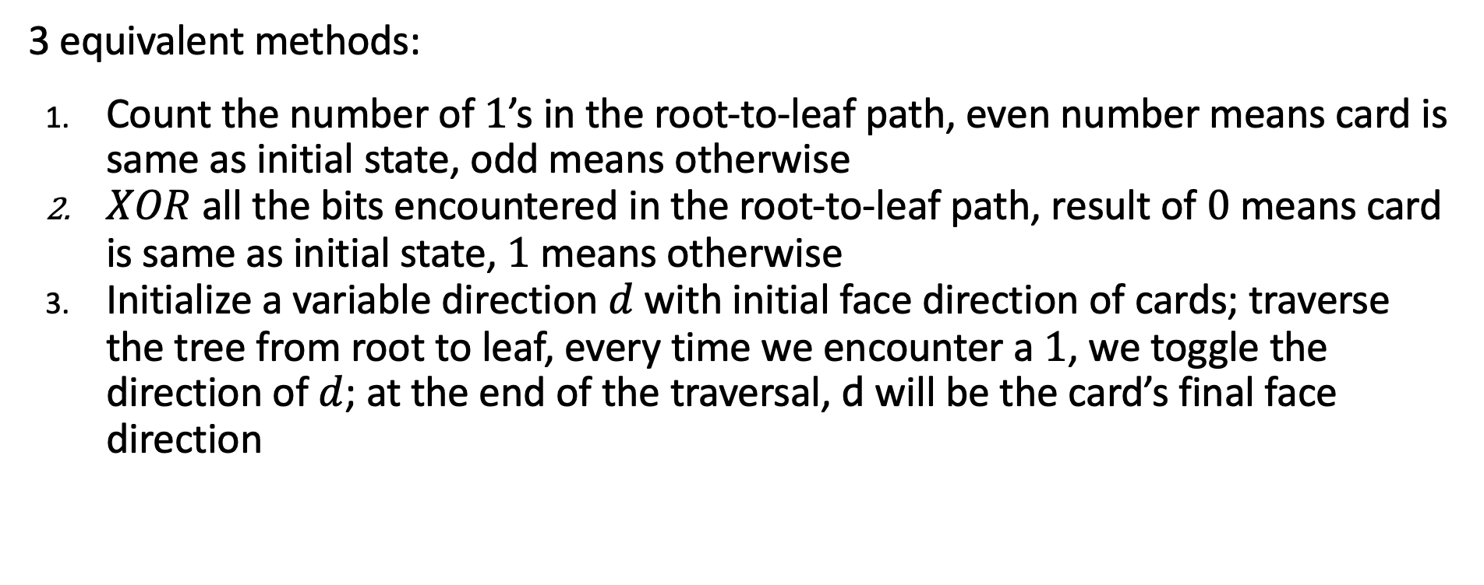
What are the face directions?
3 equivalent methods:
Count the number of $1$’s in the root-to-leaf path, even number means card is same as initial state, odd means otherwise
$XOR$ all the bits encountered in the root-to-leaf path, result of $0$ means card is same as initial state, $1$ means otherwise
Initialize a variable direction $d$ with initial face direction of cards; traverse the tree from root to leaf, every time we encounter a $1$, we toggle the direction of $d$; at the end of the traversal, d will be the card’s final face direction

Slide 57
Test yourself!
Once there is a left-right split in the search path, can the left branch have a further left split and the right branch have a further right split later on? E.g.

Slide 58
Test yourself!
Once there is a left-right split in the search path, can the left branch have a further left split and the right branch have a further right split later on? E.g.
Answer: No. This would lead to a non-contiguous subsequence.

Slide 59
Test yourself!
So, what are some bad cases for turnOver?

Slide 60
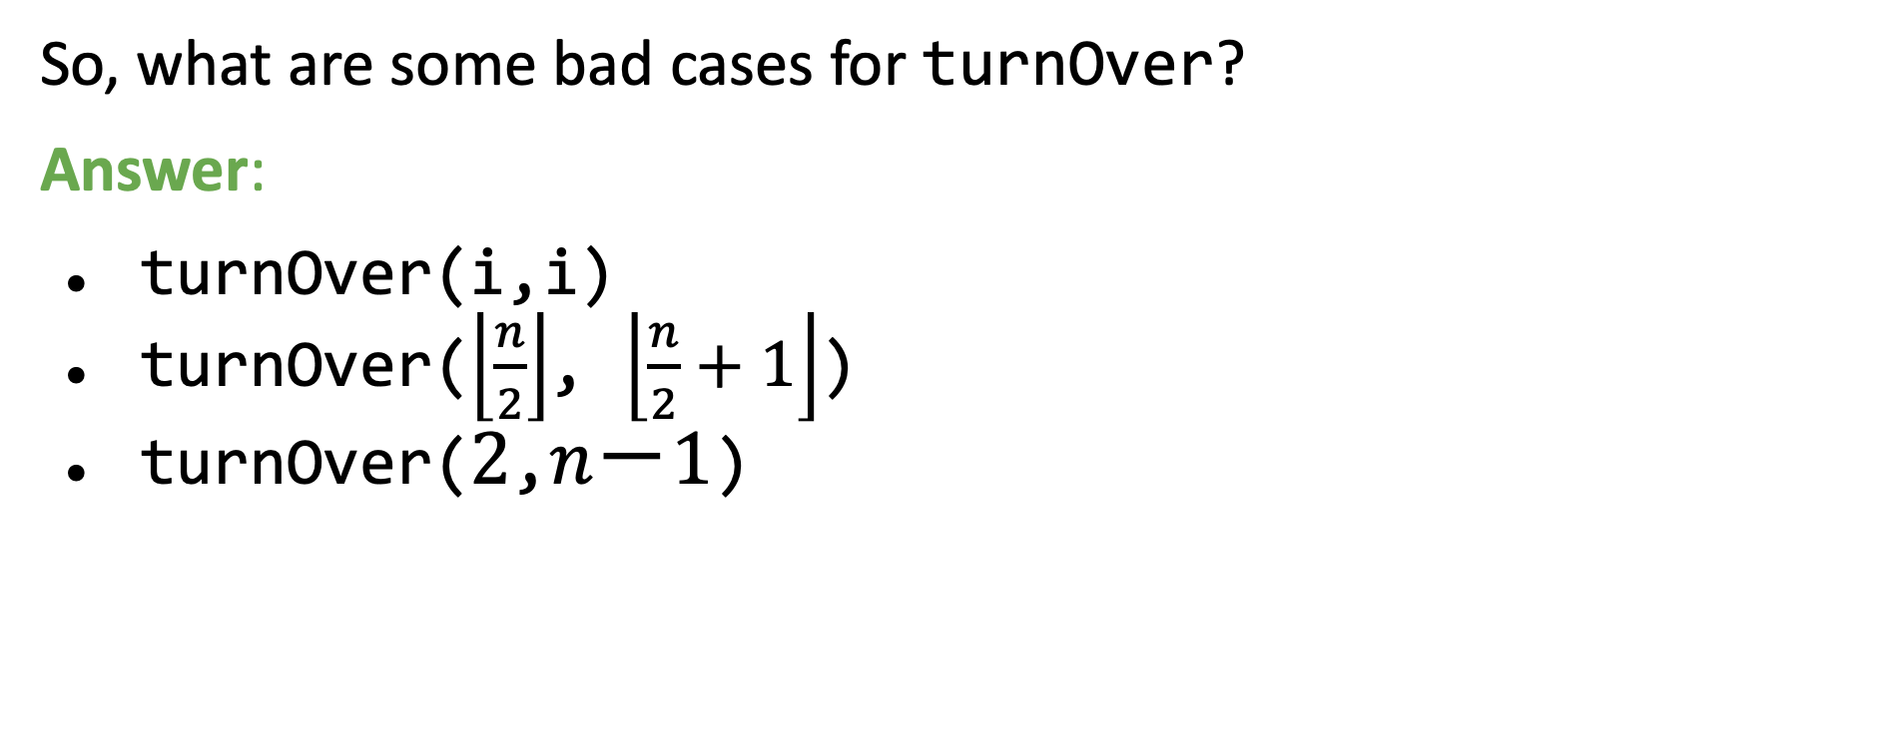
Test yourself!
So, what are some bad cases for turnOver?
Answer:
turnOver(i,i)
turnOver($\left\lfloor \frac{n}{2}\right\rfloor$, $\left\lfloor \frac{n}{2}+1\right\rfloor$)
turnOver($2$,$n－1$)

Slide 61
turnOver(4,5)
4
0
2
0
6
0
1
0
3
0
5
0
7
0
1
0
2
0
3
0
4
1
5
1
6
0
7
0
8
0

Slide 62
Test yourself!
What is the time complexity of turnOver?

Slide 63

Test yourself!
What is the time complexity of turnOver?
Answer: Worst case takes $2 × log⁡n$
Therefore time complexity is $O(log⁡n).$

Slide 64
Challenge yourself!
Do we actually need a BST to help us navigate the search?
Can we just store the state at each node and do away with the key?
Can we still support search without key ranges?

Slide 65
Challenge yourself!
In other words, can we just leave it like this?
0
0
0
0
0
0
0
0
0
0
0
0
0
0
0

Slide 66
Challenge yourself!
We index cards from 0 to 7
What do you observe from the binary representation of numbers from 0 to 7?
0
0
0
0
0
0
0
0
0
0
0
0
0
0
0
000
001
010
011
100
101
110
111

Slide 67
Challenge yourself!
Go left: 0
Go right: 1
0
0
1
0
0
0
1
0
1
0
0
0
0
0
1
0
1
0
1
0
1
0
0
0
0
0
0
0
0
000
001
010
011
100
101
110
111

Slide 68
Test yourself!
Why are we guaranteed that number of bits required will always be the same as the number of levels in the tree?

Slide 69
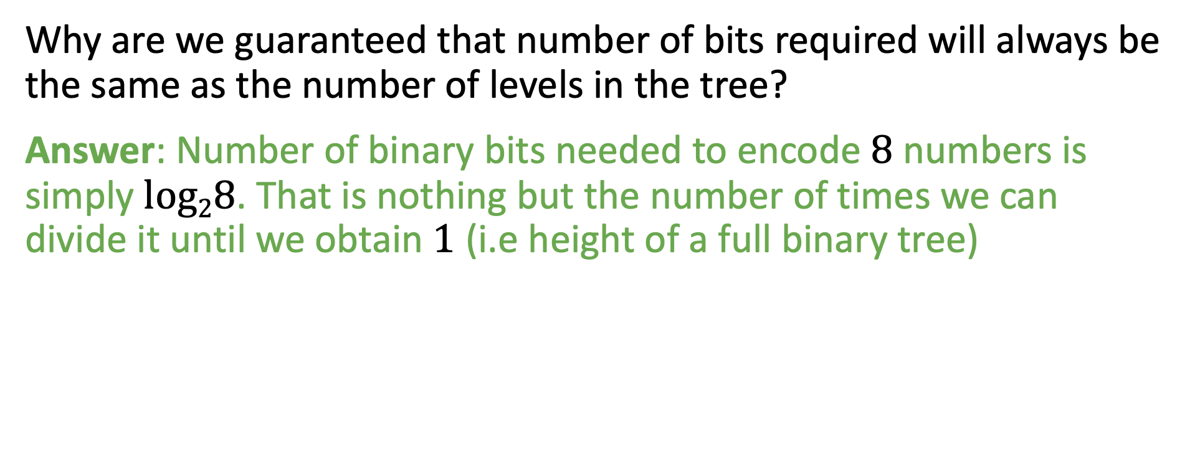
Test yourself!
Why are we guaranteed that number of bits required will always be the same as the number of levels in the tree?
Answer: Number of binary bits needed to encode $8$ numbers is simply $log28$. That is nothing but the number of times we can divide it until we obtain $1$ (i.e height of a full binary tree)

Slide 70

Test yourself!
But what if the number of cards we have isn’t a power of $2$?

Slide 71
Tree with 5 cards
Here, levels needed to capture 5 cards is ⎾log₂5⏋ which is still 3
0
0
1
0
0
0
1
0
0
0
0
0
1
0
1
0
0
0
0
0
0
000
001
010
011
100

Slide 72
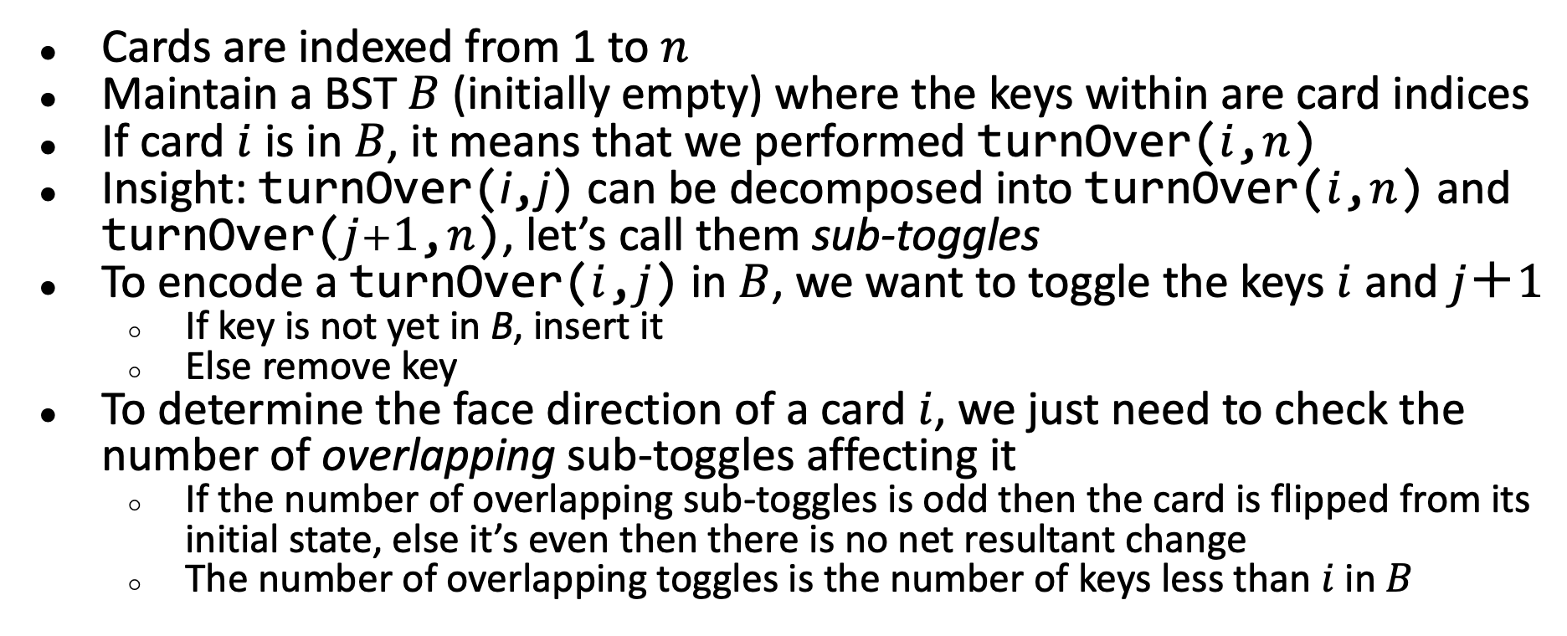
Alternative solution: Overview
Cards are indexed from 1 to $n$
Maintain a BST $B$ (initially empty) where the keys within are card indices
If card $i$ is in $B$, it means that we performed turnOver($i$,$n$)
Insight: turnOver(i,j) can be decomposed into turnOver($i$,$n$) and turnOver($j＋1$,$n$), let’s call them sub-toggles
To encode a turnOver($i$,$j$) in $B$, we want to toggle the keys $i$ and $j＋1$
If key is not yet in B, insert it
Else remove key
To determine the face direction of a card $i$, we just need to check the number of overlapping sub-toggles affecting it
If the number of overlapping sub-toggles is odd then the card is flipped from its initial state, else it’s even then there is no net resultant change
The number of overlapping toggles is the number of keys less than $i$ in $B$

Slide 73





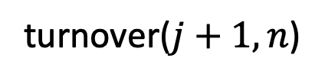


Sub-Toggles – turnover($i$,$j$)
$$i$$
$$j$$
turnover($i,n$)
$$n$$
$$i$$
turnover($j+1,n$)
$$j+1$$
$$n$$

Slide 74

Test yourself!
How to obtain the number of keys in a BST less than $i$?
What is an efficient way to implement it?

Slide 75
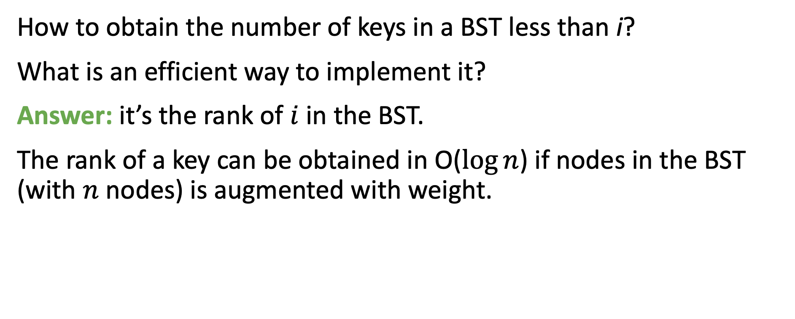
Test yourself!
How to obtain the number of keys in a BST less than i?
What is an efficient way to implement it?
Answer: it’s the rank of $i$ in the BST.
The rank of a key can be obtained in O($log⁡n$) if nodes in the BST (with $n$ nodes) is augmented with weight.

Slide 76
Alternative solution: Example
Initial state
Cards:
1
2
3
4
5
6
7
8
BST:

Slide 77
Alternative solution: Example
turnOver(2,4): insert keys 2 and 5 into BST
Cards:
1
2
3
4
5
6
7
8
Key
Weight
BST:
2
2
5
1

Slide 78
Alternative solution: Example
turnOver(3,6): insert keys 3 and 7 into BST
Cards:
1
2
3
4
5
6
7
8
BST:
3
4
Displayed after AVL-tree rotations
2
1
5
2
7
1

Slide 79
Alternative solution: Example
query(3): key 3 in BST has rank 2 (even) so same as initial state.
Cards:
1
2
3
4
5
6
7
8
BST:
3
4
2
1
5
2
7
1

Slide 80
Alternative solution: Example
query(5): key 5 in BST has rank 3 (odd) so opposite of initial state.
Cards:
1
2
3
4
5
6
7
8
BST:
3
4
2
1
5
2
7
1

Slide 81
Alternative solution: Example
query(4): There are 2 (even) keys less than 4 it in BST so same as initial state.
Cards:
1
2
3
4
5
6
7
8
BST:
3
4
2
1
5
2
7
1

Slide 82
Alternative solution: Example
query(6): There are 3 (odd) keys less than 6 it in BST so opposite of initial state.
Cards:
1
2
3
4
5
6
7
8
BST:
3
4
2
1
5
2
7
1

Slide 83
Alternative solution: Example
turnOver(3,3): delete key 3, insert key 4 into BST
Cards:
1
2
3
4
5
6
7
8
BST:
5
4
2
2
7
1
4
1

Slide 84
Alternative solution: Example
query(3): There are 1 (odd) keys less than 3 it in BST so opposite of initial state.
Cards:
1
2
3
4
5
6
7
8
BST:
5
4
2
2
7
1
4
1

Slide 85
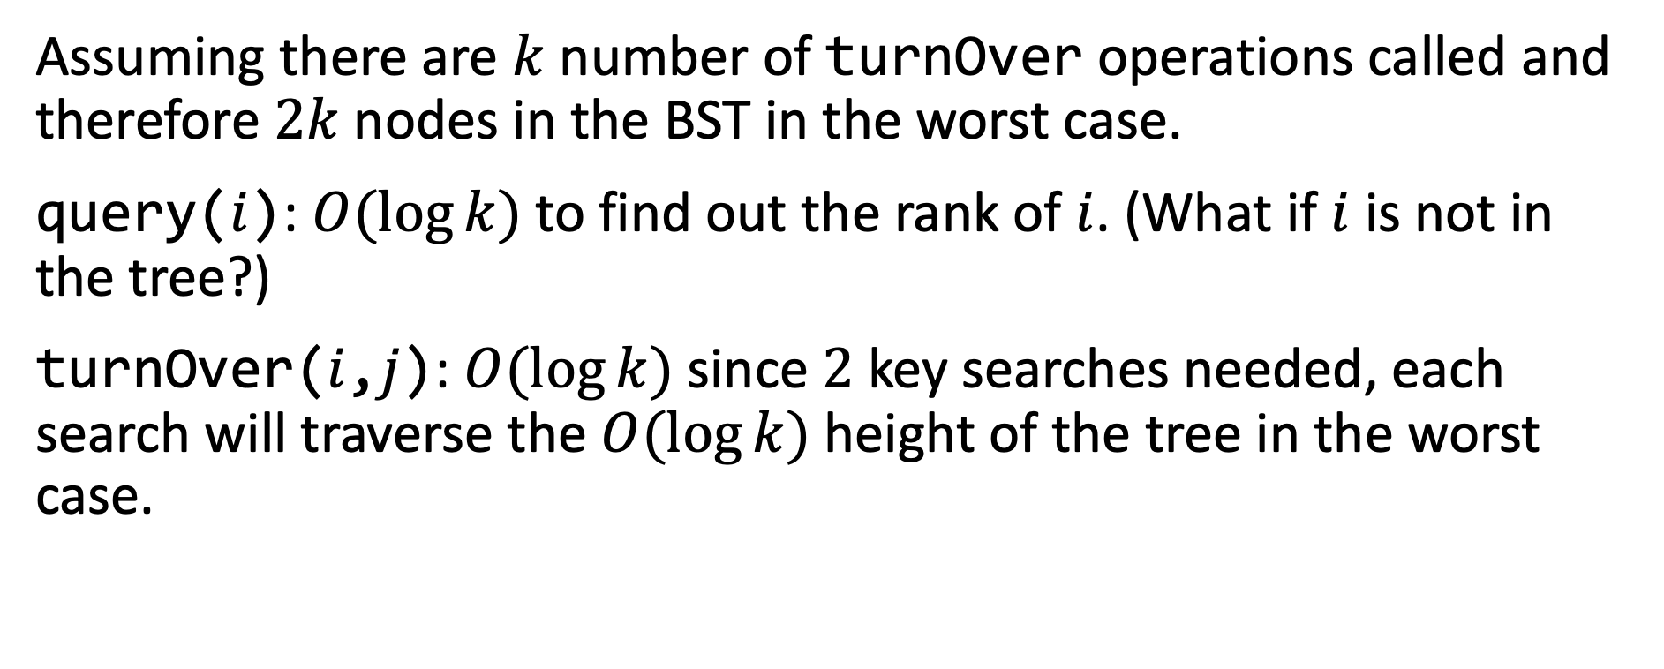
Alternative solution: Time complexity
Assuming there are $k$ number of turnOver operations called and therefore $2k$ nodes in the BST in the worst case.
query($i$): $O(log⁡k)$to find out the rank of $i$. (What if $i$ is not in the tree?)
turnOver($i$,$j$): $O(log⁡k)$since $2$ key searches needed, each search will traverse the $O(log⁡k)$height of the tree in the worst case.

Slide 86

Alternative solution: Space complexity
Space complexity is simply $O(n)$ since in the worst case, all the card indices are in the tree.

